Slide 1
Datastage – Entry Level Training
IM Competency

Slide 2
Course Contents
Module : Introduction
Module : Client Components
Module : Sequential File Stage
Module : Oracle Stage
Module : Sort Stage
Module : Aggregator Stage
Module : Parallelism/Partitioning
Module : Look Up Stage
Module : Merge Stage
Module : Join Stage
Module : Remove Duplicate Stage
Module : Funnel Stage
Module : Transformer Stage
Module : Modify Stage
Module : Filter Stage
Module : Job Sequences

Slide 3
Module : Introduction

Slide 4
History of Datastage
DataStage originated at VMark a spin off from Prime Computers during early 1996.
VMark acquired UniData in October 1997 and renamed itself to Ardent Software.
later in 1999 from Ardent Software DataStage was acquired by a company called Ascential Software.
In March 2005 IBM acquired Ascential Software and made DataStage part of the WebSphere family as WebSphere DataStage.
In 2006 the product was released as part of the IBM Information Server under the Information Management family but was still known as WebSphere DataStage.
In 2008 the suite was renamed to InfoSphere Information Server and the product was renamed to InfoSphere DataStage.

Slide 5
Module : Client Components

Slide 6
At the end of this module you will be able to:
  Set properties and Environment variables using – Administrator
  Import/Export Metadata using – Manager
  Create Compile, Execute PX Jobs using – Designer
  View job log and other options using - Director

Slide 7
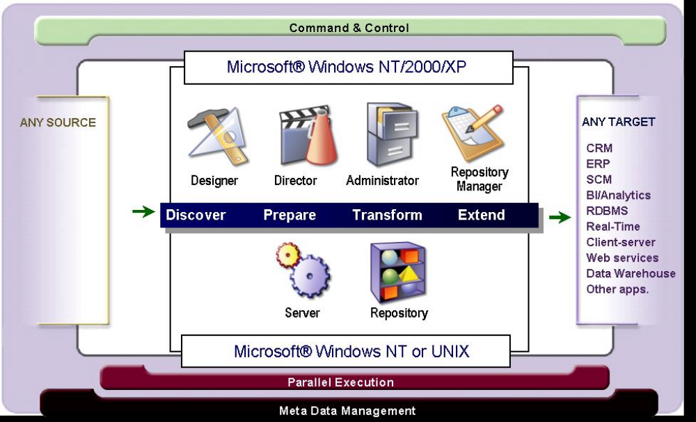
Datastage Clients

Slide 8




Data Stage client components
Administrator – add/delete projects, set defaults
Manager – import meta data, backup projects
Designer – assemble jobs, compile, and execute
Director – execute jobs, examine job run logs

Slide 9
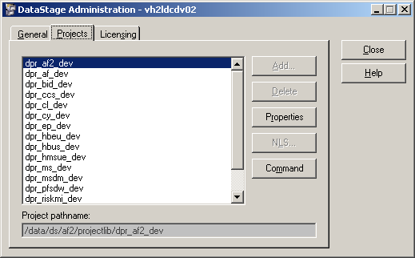
Administrator
    Setting Project Properties :
    Logon to administrator
    Select the project
    Go to Properties tab

Slide 10
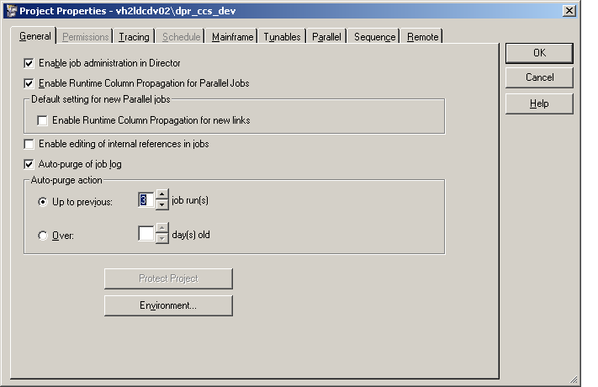
Administrator
    Projects can be created and deleted in Administrator
    Project properties are set in Administrator
    Environment variables and their defaults are set in Administrator
Environment variables are defined here

Slide 11
Administrator
    Properties
    Logon to administrator and go to Project Properties tab
    Click on Environment… button

Slide 12
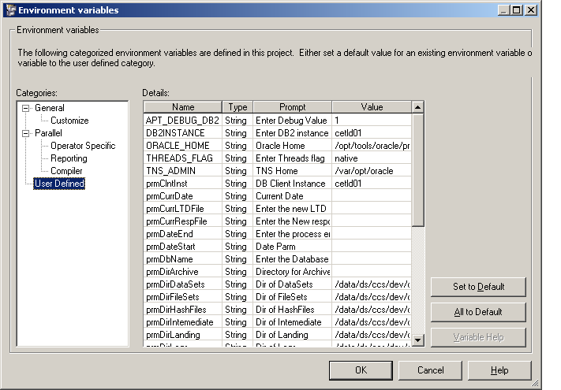
Administrator
Environment Variables

Slide 13
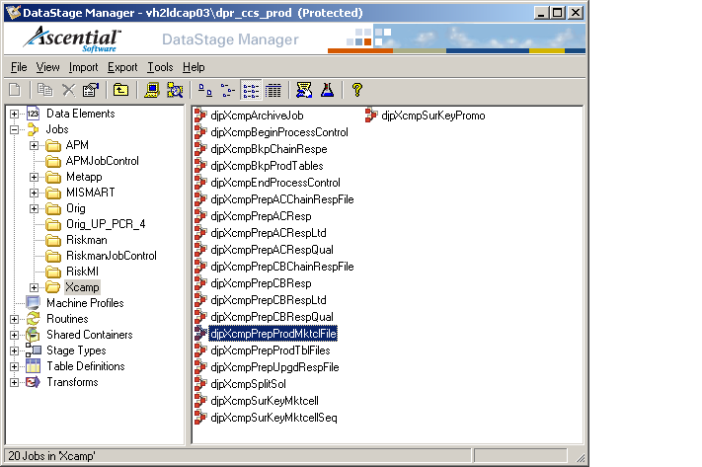
Datastage Manager
Host name
Project

Slide 14
Manager Contents
    Metadata for source and targets
        Table definitions
        Source/target sequential file/dataset layouts
    Datastage Objects
        Jobs
        Routines
        Table definitions
        Containers
        Build-ops
    Import and export components/projects
    Backup projects/components

Slide 15
Manager
    Import and Export
    Exporting datastage components
        To export using Manager Go to “ Export > Datastage components “
        Select datastage objects for export
        Specify type of export – DSX / XML
        Select path where the file to be exported to on the client machine
    Importing datastage components
        To import using Manager Go to “ Import > Datastage components”
        Select datastage objects to import

Slide 16
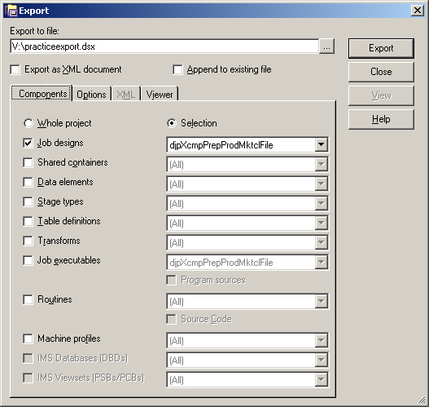
Manager – Exporting DataStage Objects

Slide 17
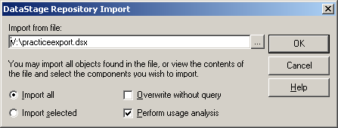
Manager – Importing DataStage Objects

Slide 18
Datastage Designer
Designer functions
        Used to build jobs
        Compile/run the created jobs
        Define the job environment variable properties

Slide 19
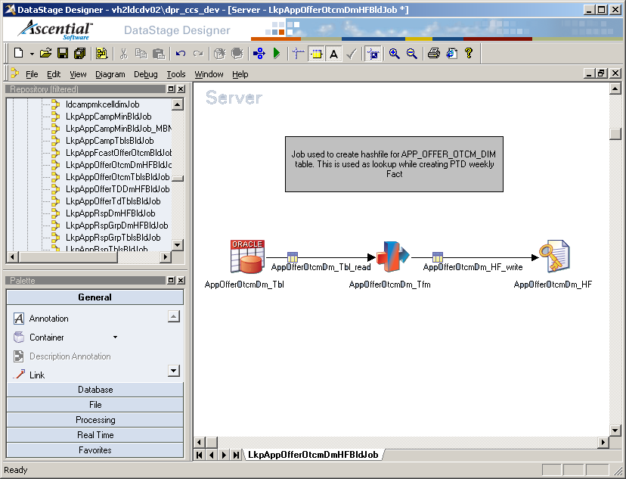
Datastage Designer
Project
Run
Host name
Job properties
Compile
Palette
Repository

Slide 20
Datastage Director - Functions
Used to control/monitor the jobs or job activity
Validate, start, stop and reset the job
Schedule job runs
View the log and filter/limit the log entries
Can change the job parameters at run-time

Slide 21
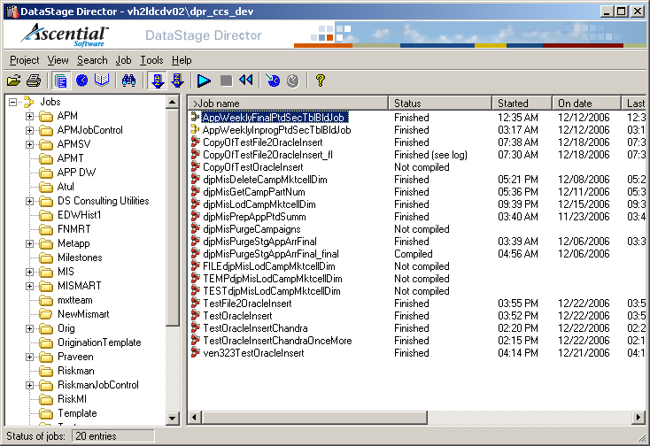
Datastage Director

Slide 22
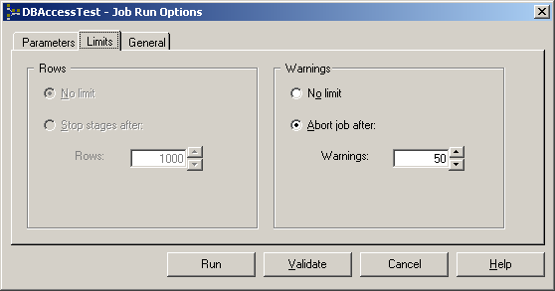
Director
Job execution/validation

Slide 23
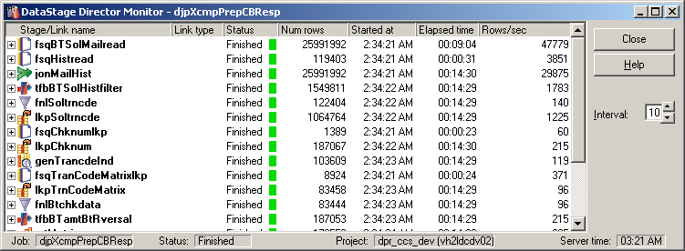
Director
Job Monitor

Slide 24
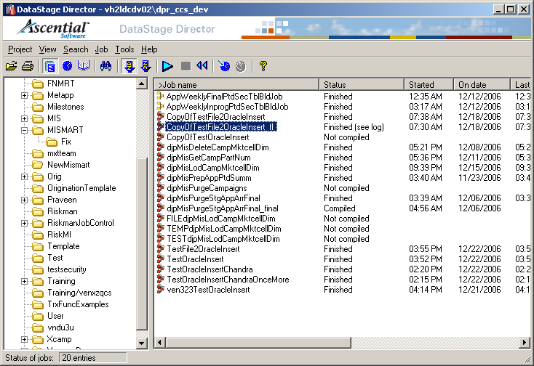
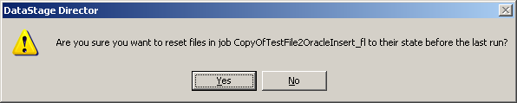
Director
Job Reset
Job Reset

Slide 25
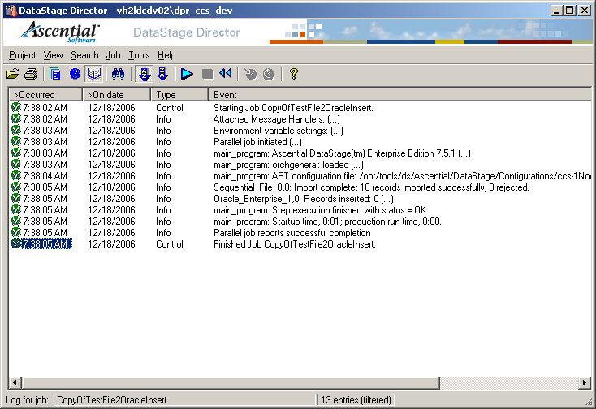
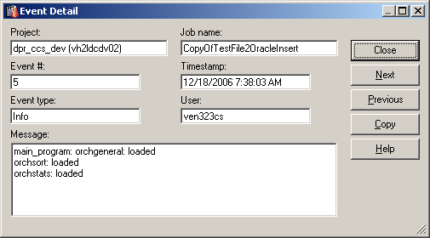
Director – Log View
Log View
Log detail

Slide 26
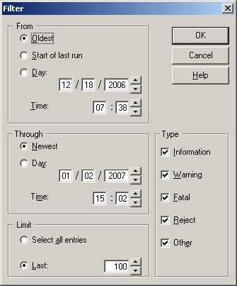
Director – Filter Log
Go to View > Filter Entries

Slide 27
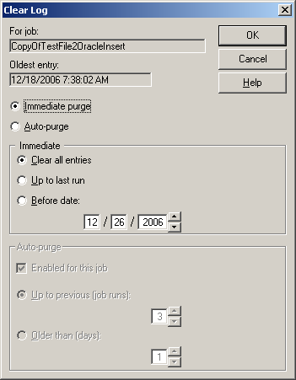
Director – Clear Log
Go to Job > Clear Log

Slide 28
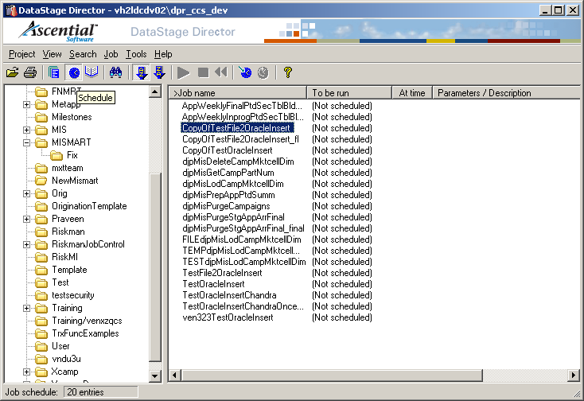
Director – Job Scheduling
View Schedule
Re-schedule
Add To Schedule

Slide 29
Module : Sequential File Stage

Slide 30
Module Objectives
Introduction
Properties
Format
Stage as a target
Advanced properties
Examples

Slide 31

Sequential File : Introduction
Sequential File Stage
The Sequential File stages are used to interact with text files which may involve extracting data from and write data to a text file.
Sequential File stages can read files, create (overwrite) or append data to a text file. It can be processed on any drive that is local or mapped as a shared folder or even on an FTP server (combined with an FTP stage).
The stage can have a single input link or a single output link, and a single rejects link.

Slide 32
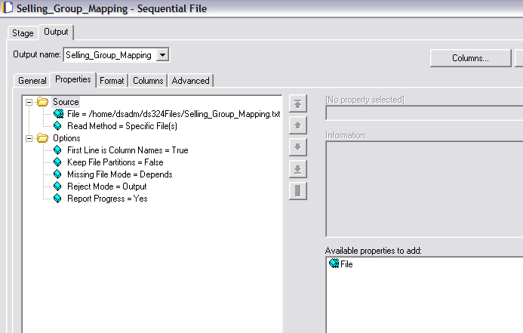
Sequential File : Stage Properties
Output tab
File to access
Column names in first row
Click to add more files having the same format

Slide 33
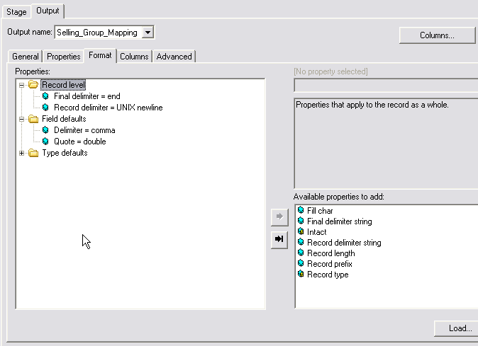
Sequential File : Format
Record format
Column format

Slide 34
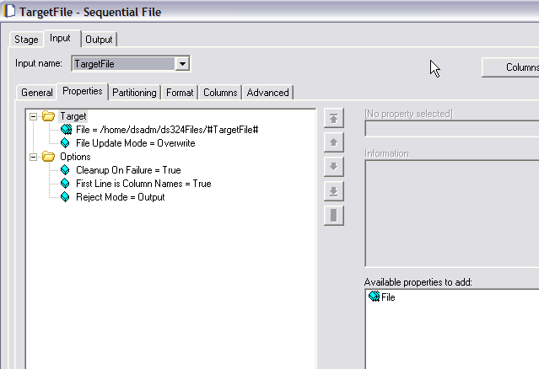
Sequential File : Stage as a target
Input Tab
Append / Overwrite

Slide 35
Sequential File : Advanced Properties
The stage executes in parallel mode if reading multiple files but executes sequentially if it is only reading one file. By default a complete file will be read by a single node (although each node might read more than one file).
The stage needs to be told:
How we will divide the files into rows (Record Level)
How we will divide the file into columns (Column Level)
Notes:
For clusterKeychange : Atleast one of the sort keys ‘Sort Mode’ should be set as Don’t Sort (Previously Sorted) or Don’t Sort (Previously Grouped), otherwise even if the clusterKeyChange column property is set to true DataStage would ignore it and would not create the clusterKeyChange Column in the ouput.

Slide 36
Sequential File : Advanced properties
We can also perform the following sorting:
Perform Sort. Select this to specify that data coming in on the link should be sorted. Select the column or columns to sort on from the Available list.
Stable. Select this if you want to preserve previously sorted data sets. This is the default.
Unique. Select this to specify that, if multiple records have identical sorting key values, only one record is retained. If stable sort is also set, the first record is retained.
Notes:
Sort Algorithm:
The Sort stage accumulates input rows in memory, limited by the Max Rows in Virtual Memory property. It sorts the accumulated rows, storing them in disk files, if necessary. (Small sort sets can be sorted in memory.) It merges these stored files and writes the rows to the output link.
The sort algorithm performs incremental sorts, This reduces the virtual memory usage and excessive page swapping that occurs when you have a large amount of input data associated with the input link.
Sort stage stores temporary files only on the scratch disks included in the sort scratch disk pool, if any are defined, and otherwise uses the default scratch disk pool.
When the parallel engine runs, it determines the locations of temporary files by:
1. Searching the parallel engine configuration for any scratch disk resources in the sort resource pool on the nodes sort will run on. If
found, the scratch disks are used as a location for temporary storage by sort.
2. If no scratch disk resources are found that belong to the disk pool sort, the system determines whether any scratch disk resources
belong to the default scratch disk pool on the nodes sort will run on. If so, the scratch disks belonging to the default pool are used
by tsort for temporary storage.
3. If no scratch disk resources are found that belong to either sort or the default scratch disk pool, the parallel engine issues a warning
message and runs sort using the directory indicated by the TMPDIR environment variable or /tmp for temporary storage.

Slide 37
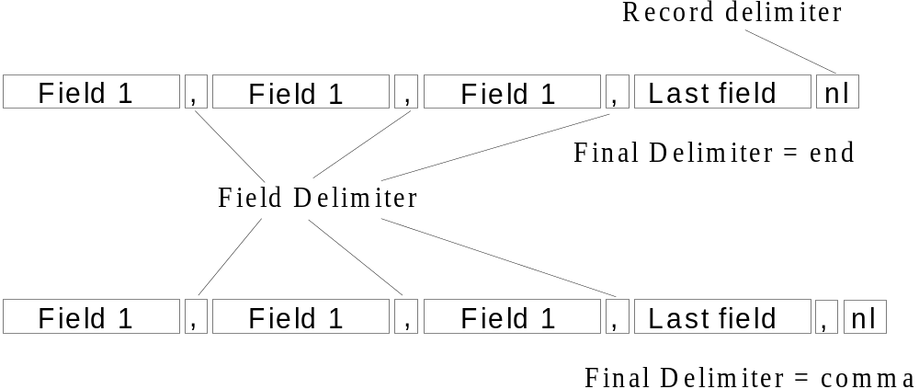
Sequential File: File Format Example

Slide 38
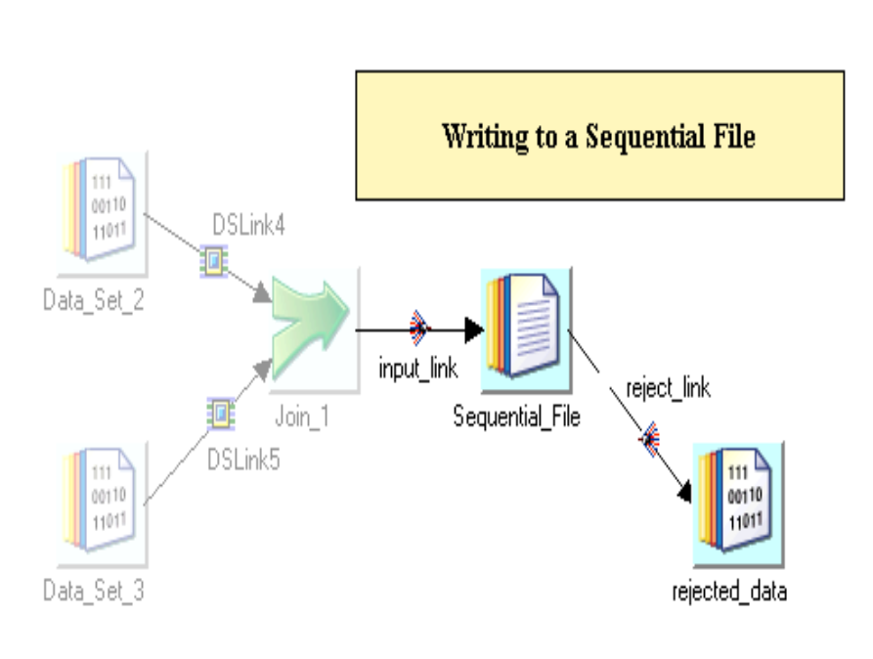
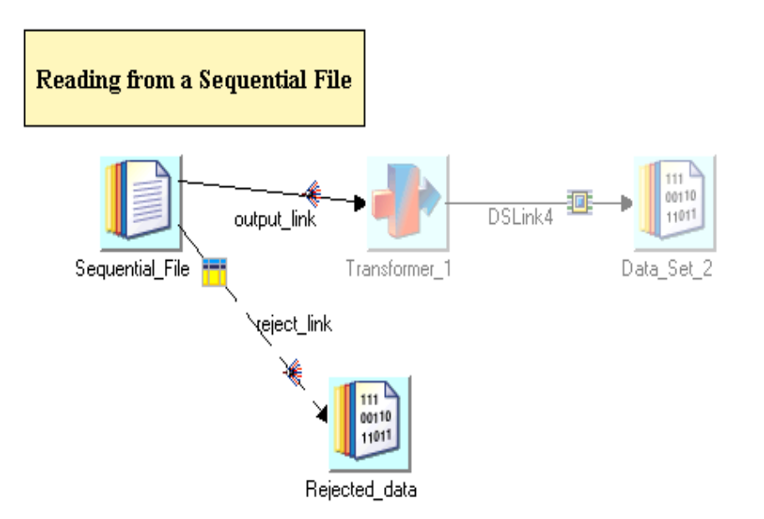
Sequential File : Examples

Slide 39
Module : Oracle Stage

Slide 40
Module Objectives
Introduction
Properties
Stage as a Source
Stage as a target
Advanced properties
Examples

Slide 41

Oracle : Introduction
Oracle Stage
The Oracle Enterprise Stage is a database stage. It allows you to read data from and write data to an Oracle database.
The Oracle Enterprise Stage can have a single input link and a single reject link, or a single output link or output reference link.
The Oracle Enterprise Stage can also be used in conjunction with a Lookup stage to access a lookup table hosted by an Oracle database.

Slide 42
Oracle : Stage Properties
The stage performs one of the following operations:
  Updates an Oracle table using INSERT and/or UPDATE as appropriate. Data is assembled into arrays and written using Oracle host-array processing.
  Loads an Oracle table (using Oracle fast loader).
  Reads an Oracle table.
  Deletes rows from an Oracle table.
  Performs a lookup directly on an Oracle table.
  Loads an Oracle table into memory and then performs a lookup on it.
When writing or loading, the Oracle Enterprise stage automatically converts DataStage data types to Oracle data types.
When reading, the Oracle Enterprise stage automatically converts Oracle data types to DataStage data types.

Slide 43
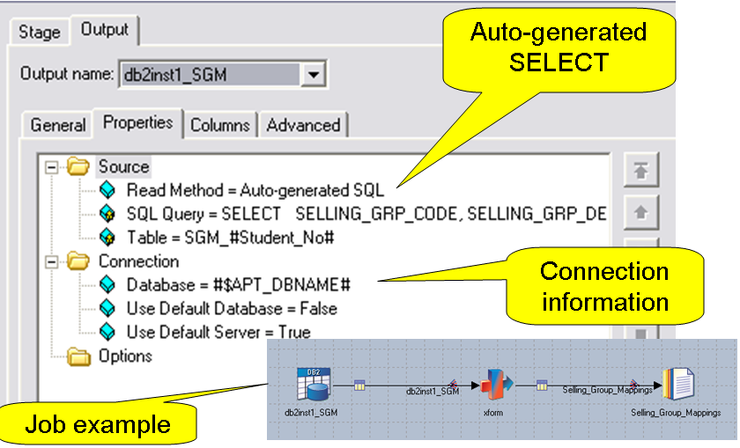
Oracle : Stage as a Source

Slide 44
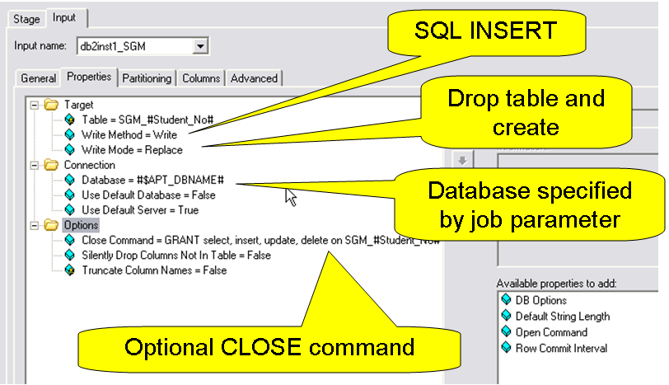
Oracle : Stage as a target

Slide 45
Oracle : Advanced Properties
As a source
  Extract data from table (stream link)
      Read methods include: Table, Generated SQL SELECT, or User-defined SQL
      User-defined can perform joins, access views
  Lookup (reference link)
      Normal lookup is memory-based (all table data read into memory)
      Can perform one lookup at a time in DBMS (sparse option)
      Continue/drop/fail options
As a target
  Inserts
  Upserts (Inserts and updates)
  Loader
Notes:
For clusterKeychange : Atleast one of the sort keys ‘Sort Mode’ should be set as Don’t Sort (Previously Sorted) or Don’t Sort (Previously Grouped), otherwise even if the clusterKeyChange column property is set to true DataStage would ignore it and would not create the clusterKeyChange Column in the ouput.

Slide 46
Oracle : Advanced properties
Write methods
  Delete
  Load
    Uses database load utility
  Upsert
    INSERT followed by an UPDATE
Write modes
  Truncate
  Create
  Replace
  Append
Notes:
Sort Algorithm:
The Sort stage accumulates input rows in memory, limited by the Max Rows in Virtual Memory property. It sorts the accumulated rows, storing them in disk files, if necessary. (Small sort sets can be sorted in memory.) It merges these stored files and writes the rows to the output link.
The sort algorithm performs incremental sorts, This reduces the virtual memory usage and excessive page swapping that occurs when you have a large amount of input data associated with the input link.
Sort stage stores temporary files only on the scratch disks included in the sort scratch disk pool, if any are defined, and otherwise uses the default scratch disk pool.
When the parallel engine runs, it determines the locations of temporary files by:
1. Searching the parallel engine configuration for any scratch disk resources in the sort resource pool on the nodes sort will run on. If
found, the scratch disks are used as a location for temporary storage by sort.
2. If no scratch disk resources are found that belong to the disk pool sort, the system determines whether any scratch disk resources
belong to the default scratch disk pool on the nodes sort will run on. If so, the scratch disks belonging to the default pool are used
by tsort for temporary storage.
3. If no scratch disk resources are found that belong to either sort or the default scratch disk pool, the parallel engine issues a warning
message and runs sort using the directory indicated by the TMPDIR environment variable or /tmp for temporary storage.

Slide 47
Oracle : Advanced properties
The characters # and $ are reserved in DataStage and special steps are needed to handle Oracle databases which use the characters # and $ in column names. DataStage converts these characters into an internal format, then converts them back as necessary.

Slide 48
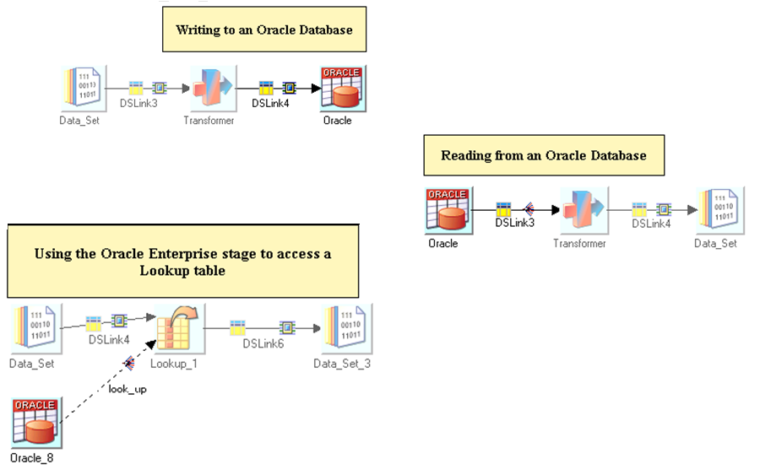
Oracle : Examples

Slide 49
Module : Sort Stage

Slide 50
Module Objectives
At the end of this module you will be able to:
  Use the Sort Stage/In-Stage Sort features for sorting data
  Describe the different properties available with Sort Stage/In-Stage sort
  Sorting data in sequential and parallel modes

Slide 51


Sorting :
Sorting of data in Datastage can be performed using
    In-stage sort/In-Link sort feature :
    Sort Stage :
Basic sort operations can be performed using the in-Stage Sort
  stable & unique are the available operations
  Implicit, shown on the link as a small sort stage symbol
Sort stage provides more operations
  Sort stage makes the sort operation shown more explicitly in the job design
  More operations
    Key Change, Cluster Key Change operations etc…
  Allows restricting the Sort stages Memory Usage

Slide 52
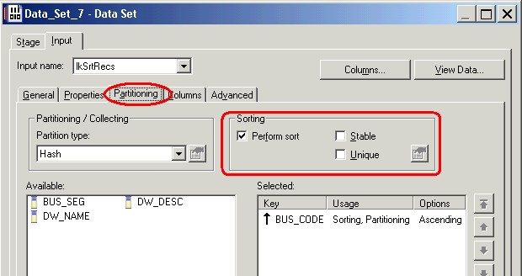
In-Stage / In-Link Sorting :
There is a standard feature available in the stage editor for sorting the incoming records.
Partitioning Tab (present on the input page) of all the stages provides this feature.

Slide 53
In-Stage / In-Link Sorting :
‘Perform Sort’ Checkbox enabled
  Specifies that data coming in on the link will be sorted.
  Select the column or columns to sort on (Sort Keys) from the ‘Available’ list.
‘Stable’ Checkbox enabled
  Preserves the previously sorted order of the incoming data
‘Unique’ Checkbox enabled
  When multiple input records have identical sorting key values, only one record is retained.
  If stable sort is also enabled, the first record is retained.
Notes:
You can also mention the sort direction (Ascending/Descending) for each selected sort keys
You can specify if the fields are sorted as case sensitive/insensitive (for the char fields)
whether sorted as ASCII or EBCDIC
Specify if NULL columns will appear first or last for each column.
Also you can specify if the keys are used for (When you are using a keyed partitioning method)
sorting or
partitioning or
for both

Slide 54
In-Stage / In-Link Sorting :
In-Stage Sorting feature is enabled
  Both when the stage is operating in sequential and parallel modes
  When the stage is set to operate in Parallel mode and
    Partitioning/Collector Type is not set to ‘Auto’
    For All other partitioning/collecting types the sort feature is enabled
Sorting is always done within the data partitions (when stage is operating in parallel)
When the stage is partitioning data
  The sorting is done after partitioning
If the stage is collecting data
  Sorting is performed before the collection **
Notes:
** In this case the collection type should be specified carefully based on the partitioning type set in the previous stages so that the total output data remains fully sorted.

Slide 55
Sort Stage :
Active/Processing stage with Single input link and single output link
Sorting keys are specified as criteria to perform sort
Can use DataStage (tsort) or the UNIX Sort (sort command) operator
Sorts entire input data in sequential mode and sorts data within partitions in parallel mode
Does not change the data from input to output
Output field names can be different from the input, mapping can be done in the ‘Output’ page of the stage editor

Slide 56
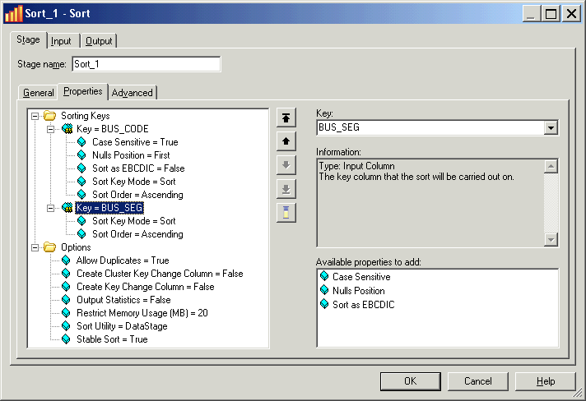
Sort Stage : Stage Properties
For the key ‘BUS_CODE’ all available properties have been selected (with default values)
You can mention multiple Key Fields.
All available properties for ‘Options’ have been selected (with default values)

Slide 57
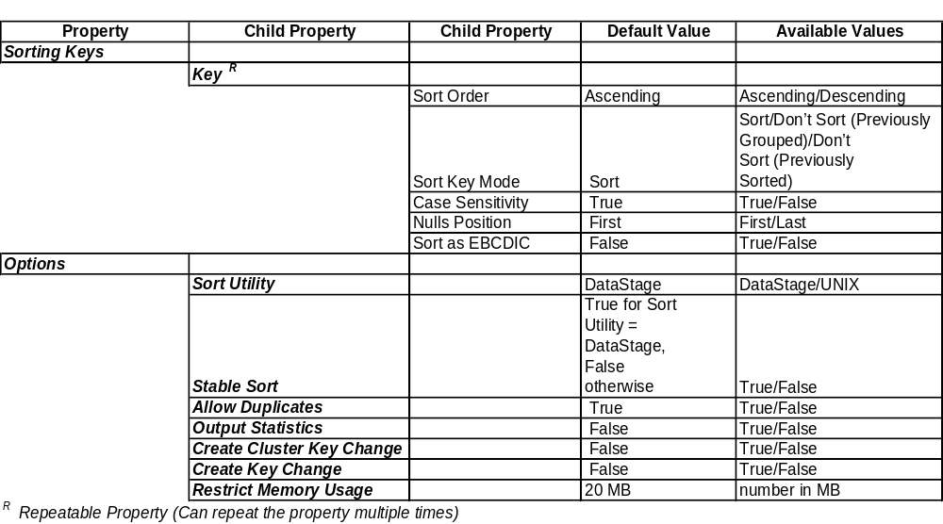
Sort Stage : Available Properties
Notes:
Sort Mode ‘Don’t sort (previously sorted)’ means:
Assume the data has already been sorted by this ke
Continue sorting by any secondary keys
All the properties except the ‘Workspace’ property are available with Sort Utility as DataStage
Following are the only properties available for Sort Utility ‘UNIX’
For ‘Key’ property only the Case Sensitivity and Sort Order properties are available
For ‘Options’ property Restrict Memory Usage and Workspace are the only properties available

Slide 58
Sort Stage : Properties
Create Key Change Column
  When set to true, a new field ‘KeyChange’ is created in the output
  KeyChange column is set to 1 for the first record in each group (records having the same value in the sorting key[s])
  For all the subsequent records in the group KeyChange is set to 0
Create Cluster Key Change Column
  When set to true, a new field ‘clusterKeyChange’ is created in the output
  clusterKeyChange column is set to 1 for the first record in each clustered group
  Subset of the sorting keys may be designated as clustered keys by specifying ‘Sort Key Mode’ as Don’t Sort (Previously Sorted) or Don’t Sort (Previously Grouped)
  Successive input records with the same value in the clustered keys are treated as a group
Notes:
For clusterKeychange : Atleast one of the sort keys ‘Sort Mode’ should be set as Don’t Sort (Previously Sorted) or Don’t Sort (Previously Grouped), otherwise even if the clusterKeyChange column property is set to true DataStage would ignore it and would not create the clusterKeyChange Column in the ouput.

Slide 59
Sort Stage : Advanced
Small amounts of input data is sorted efficiently in memory
Large amounts of data is sorted using the temporary disk storage, not the virtual memory swap space.
Define a sort scratch disk pool in the config file to assign scratch disk space explicitly for the storage of temporary files created by the Sort stage.
Sort Stage can be made to run on specific nodes by specifying the Node map Constraints in the ‘Advanced Tab’ of the stage editor
Notes:
Sort Algorithm:
The Sort stage accumulates input rows in memory, limited by the Max Rows in Virtual Memory property. It sorts the accumulated rows, storing them in disk files, if necessary. (Small sort sets can be sorted in memory.) It merges these stored files and writes the rows to the output link.
The sort algorithm performs incremental sorts, This reduces the virtual memory usage and excessive page swapping that occurs when you have a large amount of input data associated with the input link.
Sort stage stores temporary files only on the scratch disks included in the sort scratch disk pool, if any are defined, and otherwise uses the default scratch disk pool.
When the parallel engine runs, it determines the locations of temporary files by:
1. Searching the parallel engine configuration for any scratch disk resources in the sort resource pool on the nodes sort will run on. If
found, the scratch disks are used as a location for temporary storage by sort.
2. If no scratch disk resources are found that belong to the disk pool sort, the system determines whether any scratch disk resources
belong to the default scratch disk pool on the nodes sort will run on. If so, the scratch disks belonging to the default pool are used
by tsort for temporary storage.
3. If no scratch disk resources are found that belong to either sort or the default scratch disk pool, the parallel engine issues a warning
message and runs sort using the directory indicated by the TMPDIR environment variable or /tmp for temporary storage.

Slide 60


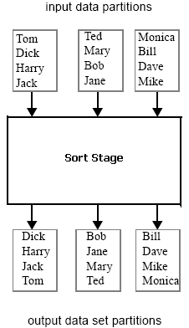
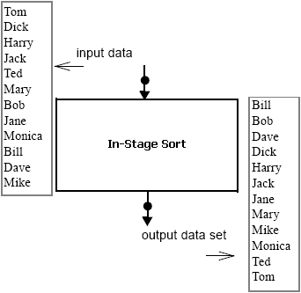
Sort Stage : Example Job
Sort Stage operating in Parallel mode
In-Stage/In-Link Sequential Sort
Input Data is Partitioned

Slide 61
Sort Stage : More…
Caution
  Re-Partitioning can destroy the sort order of previously sorted data
  Same partitioning method can be used to maintain the sort order in such situations
Total Sort
  A total sort requires that all similar (based on the key fields) and duplicate records are located in the same partition of the data set.
  The partitions also need to be approximately the same size so that no one node becomes a processing bottleneck.
  Using the range partitioning method in the sort will solve the purpose

Slide 62
Module : Aggregator Stage

Slide 63
Module Objectives
At the end of this module you will be able to:
  Use the aggregator stage to group data
  Describe the different summarizing operations available
  Describe the operating methods of the stage

Slide 64
Aggregator Stage :
Active/Processing stage with Single input link and single output link
Groups input data rows on specified grouping keys/fields and computes counts or other aggregate functions for each group
You can specify zero or more grouping key fields
Output records contain a field for every grouping key, and a field for every summary field added by the operator.
Operates both in sequential and parallel modes
Two methods of Grouping : Hash and Sort
Uses Orchestrate Operators : group/statistics

Slide 65
Aggregator Stage : Aggregation Types
Available types of aggregation :
  Count Rows :
    Counts the number of rows within each group ( set of records having same values for the specified grouping fields )
    We have to specify the output column name which holds the count
  Calculation (Default Type) :
    Summarizes on specified column(s) for each group based on grouping keys, can specify multiple columns for calculation
    By default all calculation columns have an output type of double.
    ‘Decimal Output’ : property allows you to specify that the calculation column has an output type of decimal
    Operations available : sum, mean, variance, standard deviation etc.,
Notes:
Weighting column
Configures the stage to increment the count for the group by the
contents of the weight column for each record in the group, instead of
by 1. Not available for Summary Column for Recalculation. Setting
this option affects only the following options:
􀂄 Percent Coefficient of Variation
􀂄 Mean Value
􀂄 Sum
􀂄 Sum of Weights
􀂄 Uncorrected Sum of Squares

Slide 66
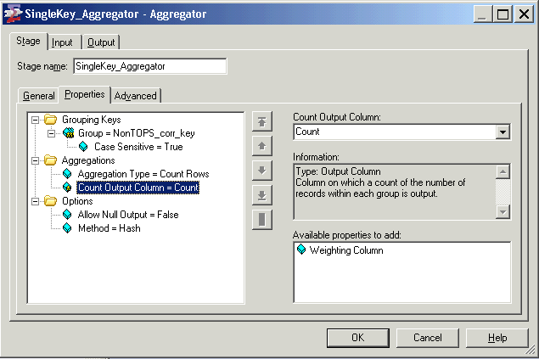
Aggregator Stage : Properties
Aggregation Type : Count Rows
All available properties shown for grouping type : Count Rows
Can specify multiple grouping keys
Have to mention the name of the output field which should contain the count
Notes:
By default the aggregator stage would create the output counted field as double
This Aggregation type simply gives the number of rows in each of the group (grouping is done based on the Grouping Keys specified)

Slide 67
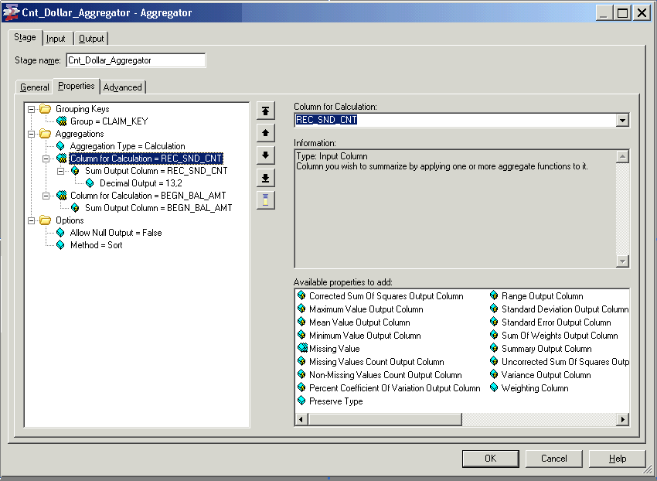
Aggregator Stage : Properties
Aggregation Type : Calculation
By default output type of the calculated field will be double. That can be overridden using this property
All the available calculation operations
Grouping Method : sort
Aggregator expects input data to be sorted on the grouping keys

Slide 68
Aggregator Stage : Grouping Methods
Sort and Hash are the two grouping methods available, choice depends on number of distinct groups in input and memory available.
Hash (Default Method) :
  Input data should be hash partitioned on one or more of grouping fields
  Running summaries for each group are maintained as in-memory hash tables
  Final results are written out only when all input records have been processed
  Works efficiently when the distinct number of groups is small
Sort :
  Requires input data to be sorted on all the grouping keys
  At any point of time, only one groups running summary is maintained in-memory
  Results are written out whenever a new group is encountered
Sort method works more efficiently than hash when there are more number of grouping keys used/ the number of distinct groups are more.
Notes:
You typically use hash mode
for a relatively small number of groups; generally, fewer than about 1000 groups per megabyte of memory to be used
Input data should be hash partitioned by one or more of grouping field
Any other partitioning method can be used if keeping group records in the same partition is not necessary
sort mode requires the input data set to have been partition
sorted with all of the grouping keys specified as hashing and sorting keys.

Slide 69
Aggregator Stage : More…
Caution
  When aggregating data (using most of the grouping operations) it is important that all the records pertaining to a single grouping key combination are present in the same partition
    ex: calculating total salary received in a year for an employee, considering EMPID and YEAR to be grouping keys all records pertaining to the key combination should be in a same partition otherwise we will end up having multiple summaries for each EMPID , YEAR combination
When using aggregator with Sort method operating in Sequential mode, use the ‘sortmerge’ collector as collection method
It is not mandatory to use hash partitioning with Hash Method if keeping groups together in a single partition is not important.
  ex: If you are doing an incremental aggregation i.e, summing records in
  each partition and later adding the sums across all partitions
Use hash mode for a relatively small number of groups; generally, fewer than about 1000 groups per megabyte of memory to be used.

Slide 70
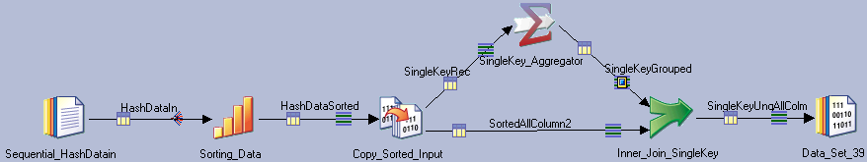
Aggregator Stage : Example Job Design
Same partitioning is used so that the sort order is maintained for aggregation
Summarizing/Grouping the records based on the grouping keys using Method ‘Sort’
Sorting the data on the grouping keys before aggregating

Slide 71
Module : Parallelism

Slide 72
Module Objectives
At the end of this module you will be able to:
  Understand the concept of parallelism in Datastage
  Types of Parallelism
  Understand Parallel Processing Environments
  Usage of Different types of Partitioning

Slide 73
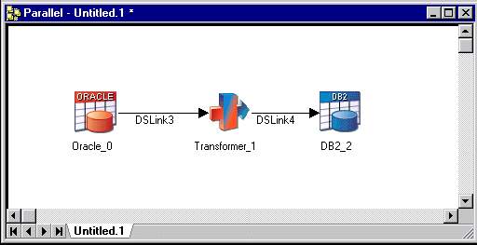
Parallelism
DataStage Parallel Extender brings the power of parallel processing to your data extraction and transformation applications.
Two basic types of parallel processing; pipeline and partitioning.

Slide 74
Pipeline Parallelism
Pipeline parallelism means that as soon as data is available between stages( in pipes or links), it can be exchanged between them without waiting for the entire record set to be read.
If there are 3 stages and at least three processors, the stage reading would start on one processor and start filling a pipeline with the data it had read.
The transformer stage would start running on another processor as soon as there was data in the pipeline, process it and start filling another pipeline.
The stage writing the transformed data to the target database would similarly start writing as soon as there was data available enabling all three stages are operating simultaneously.

Slide 75
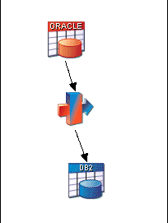
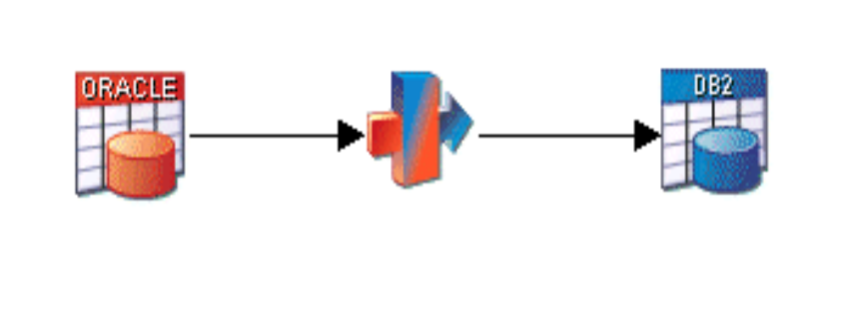
Parallelism vs No Parallelism
Time taken
Time taken
Conceptual representation of job running with no parallelism
pipeline parallelism

Slide 76
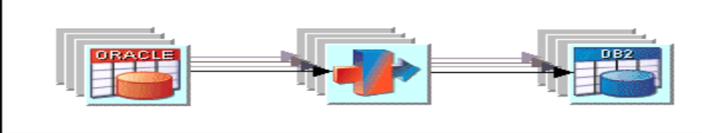
Partition Parallelism
Conceptual representation of job using partition parallelism
Partitioning parallelism means that entire record set is partitioned into small sets and processed on different nodes (logical processors).
Using partition parallelism the same job would effectively be run simultaneously by several processors, each handling a separate subset of the total data.

Slide 77
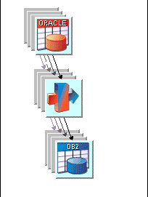
Combining Pipeline and Partition Parallelism
In this scenario you would have stages processing partitioned data and
filling pipelines.
Conceptual representation of job using pipeline and partition parallelism

Slide 78
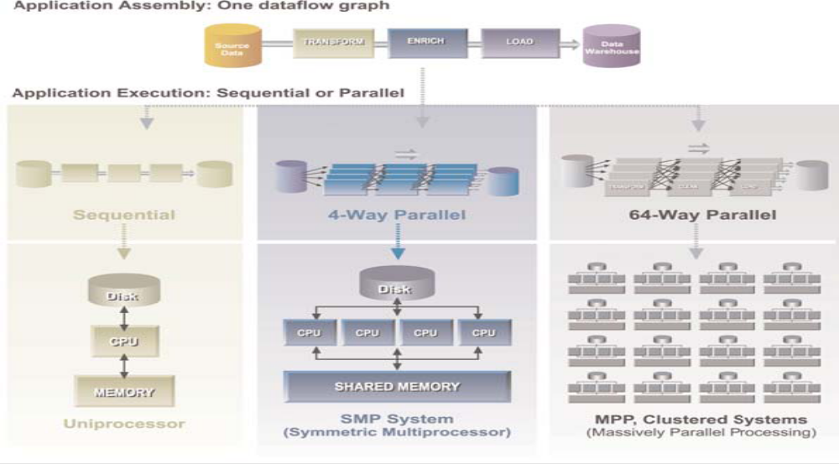
Parallel Processing Environments

Slide 79
Parallel Processing Environments
The environment in which you run your DataStage jobs is defined by your system’s architecture and hardware resources. All parallel processing environments are categorized as one of:
  SMP (symmetric multiprocessing), in which some hardware resources may be shared among processors. The processors communicate via shared memory and have a single operating system.
  Cluster or MPP (massively parallel processing), also known as shared-nothing, in which each processor has exclusive access to hardware resources. The processors each have their own operating system, and communicate via a high-speed network.

Slide 80
Configuration File
DataStage learns about the shape and size of the system from the configuration file.
It organizes the resources needed for a job according to what is defined in the configuration file. When your system changes, you change the file not the jobs.
You don’t have to worry too much about the underlying structure of your system and its parallel processing capabilities.
If your system changes or upgraded or improved, or if you develop a job on one platform and implement it on another, you don’t necessarily have to change your job design.

Slide 81
Configuration File continued..…
The configuration file describes available processing power in terms of processing nodes. These may, or may not, correspond to the actual number of processors in your system.
The number of nodes you define in the configuration file determines how many instances of a process will be produced when you compile a parallel job.
When you modify your system by adding or removing processing nodes or by reconfiguring nodes, you do not need to alter or even recompile your DataStage job. Just edit the configuration file.

Slide 82
Different types of Partitioning
Aim of most partitioning operations is to end up with a set of partitions that are as near equal size as possible, ensuring an even load across your processors
If you are using an aggregator stage to summarize your data. To get the answers you want (and need) you must ensure that related data is grouped together in the same partition before the summary operation is performed on that partition.

Slide 83
Different types of Partitioning – Round Robin
  The first record goes to the first processing node, the second to the second processing node, and so on.
  When DataStage reaches the last processing node in the system, it starts over.
  It creates approximately equal-sized partitions.
  It is used when DataStage initially partitions data.

Slide 84
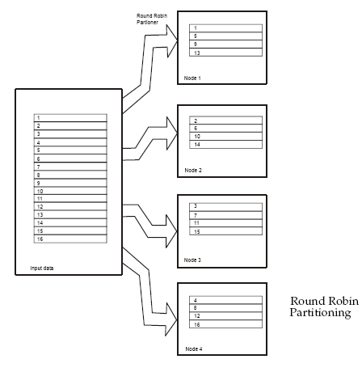
Different types of Partitioning – Round Robin

Slide 85
Different types of Partitioning – Random
  Records are randomly distributed across all processing nodes.
  It rebalances the partitions of an input data set to guarantee that each processing node receives an approximately equal-sized partition.
  It has slightly higher overhead than round robin because of the extra processing required to calculate a random value for each record.

Slide 86
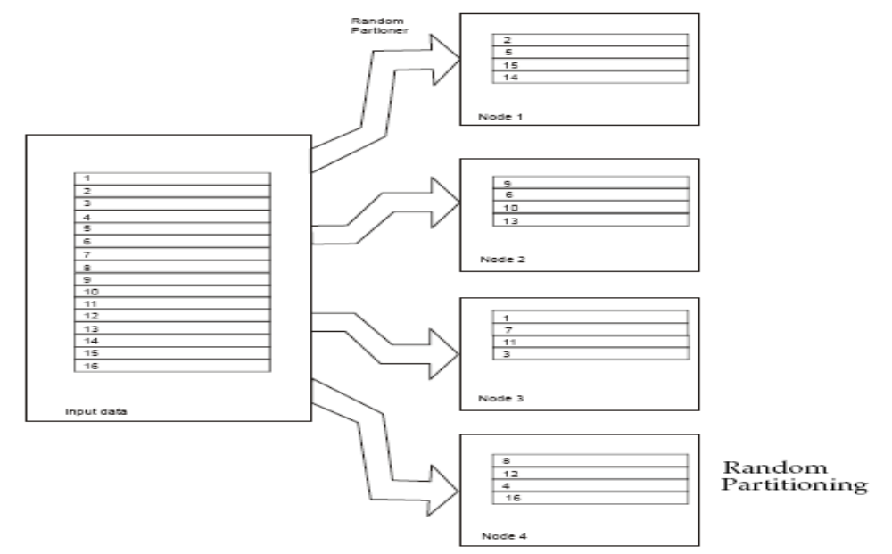
Different types of Partitioning – Random

Slide 87
Different types of Partitioning – Same
  The operator using the data set as input performs no repartitioning and takes as input the partitions output by the preceding stage.
  The records stay on the same processing node, that is, they are not redistributed.
  It is the fastest partitioning
  DataStage uses when passing data between stages in your job.

Slide 88
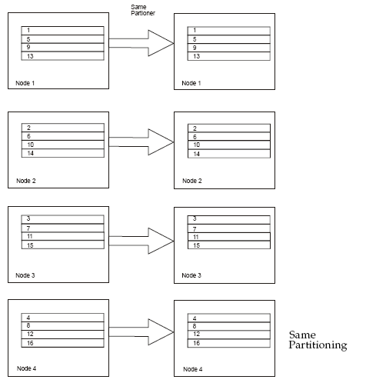
Different types of Partitioning – Same

Slide 89
Different types of Partitioning – Entire
  Every instance of a stage on every processing node receives the complete data set as input.
  Every instance of the operator needs access to the entire input data set.
  This partitioning method is used with stages that create lookup tables from their input.

Slide 90
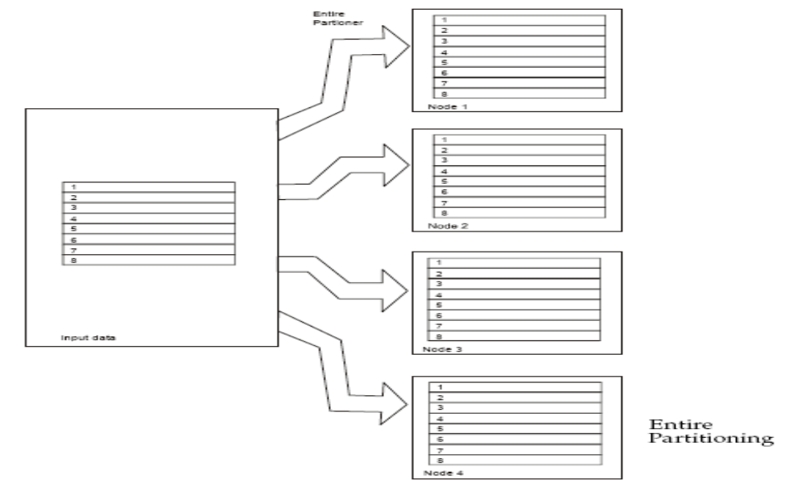
Different types of Partitioning – Entire

Slide 91
Different types of Partitioning – Hash
  In hash partitioning one or more fields of each input record are taken as the hash key fields.
  Records with the same values for all hash key fields are assigned to the same processing node.
  It is useful for ensuring that related records are in the same partition, which may be a prerequisite for a processing operation.
  For a remove duplicates operation, you can hash partition records so that records with the same partitioning key values are on the same node.
  The records can be sorted on each node using the hash key fields as sorting key fields, then remove duplicates, again using the same keys.
  Hash partitioning does not necessarily result in an even distribution of data between partitions.

Slide 92
Different types of Partitioning – Modulus
  Partitioning is based on a key column modulo the number of partitions.
  It is similar to hash by field, but involves simpler computation\
  The partition number of each record is calculated as follows:
partition_number = fieldname mod number_of_partitions
fieldname is a numeric field of the input data set.
number_of_partitions is the number of processing
nodes.

Slide 93
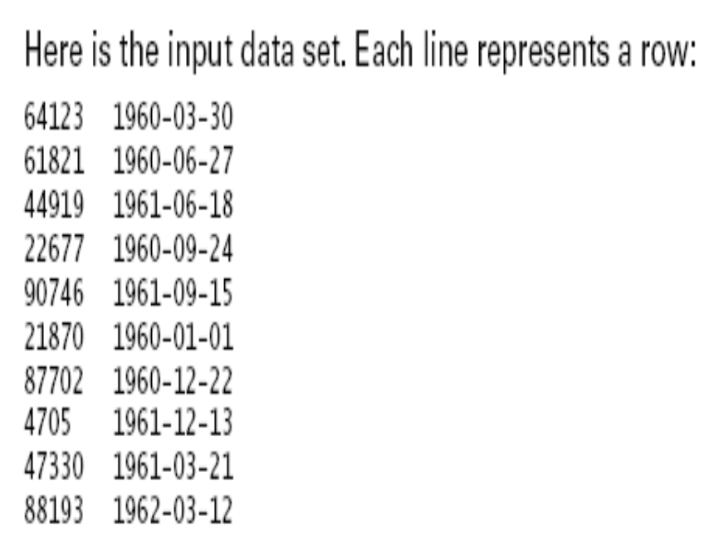
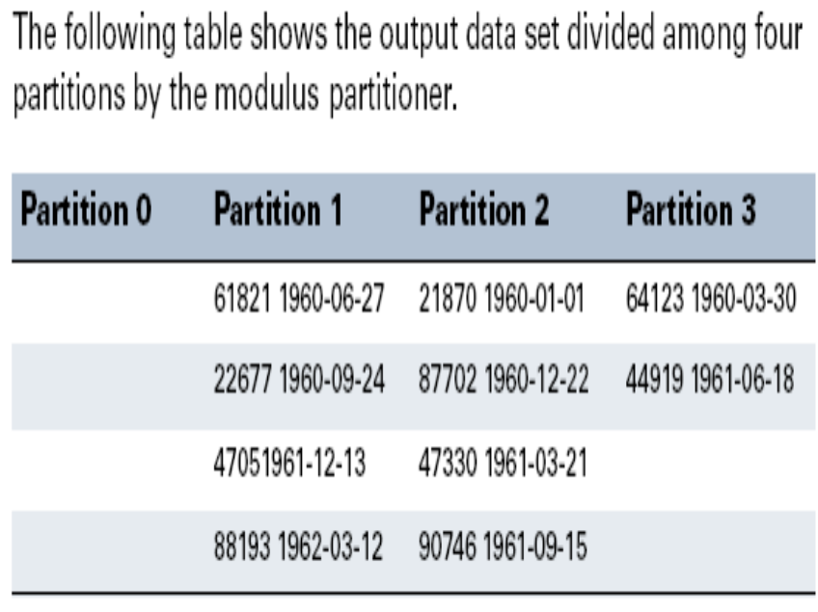
Different types of Partitioning – Modulus

Slide 94
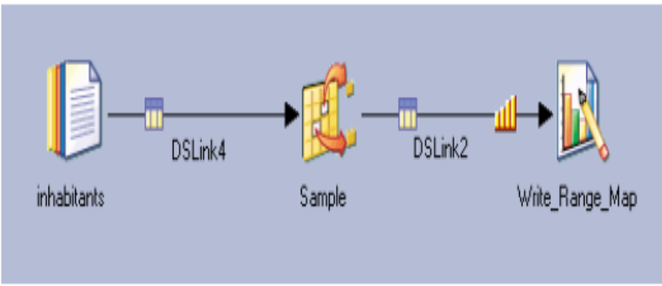
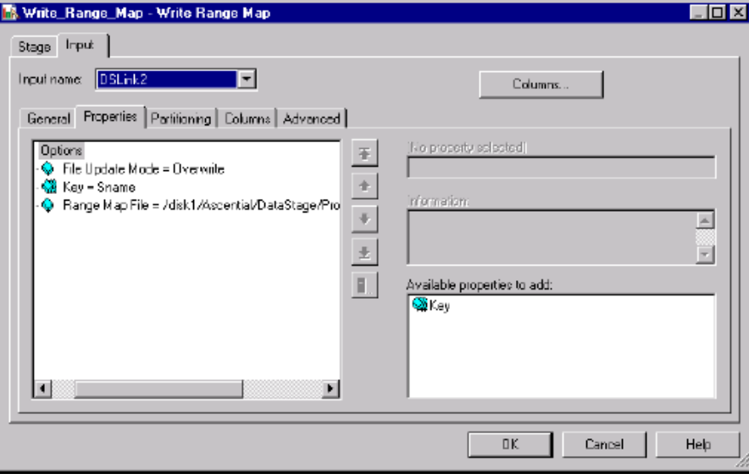
Different types of Partitioning – Range
  Divides a data set into approximately equal-sized partitions, each of which contains records with key columns within a specified range.
  A range partitioner divides a data set into approximately equal size partitions based on one or more partitioning keys.
  A range map is created using the Write Range Map stage.

Slide 95
Different types of Partitioning – DB2 and Auto
DB2
  Partitions an input data set in the same way that DB2 would partition it.
Auto
  The most common method you will see on the DataStage stages.
  Typically DataStage would use round robin when initially partitioning data, and same for the intermediate stages of a job.

Slide 96
Module : Lookup Stage

Slide 97
Module Objectives
At the end of this module you will be able to:
  Understand the functionality of Lookup Stage
  Implement the lookup stage
  Understand the pre-requisites for Lookup Stage
  Handle lookup failures and take relevant action

Slide 98

Lookup Stage:
Lookup Stage
The lookup stage is used to map short codes in the input
data set onto expanded information from a lookup table which is then
joined to the incoming data and output.
Lookups can also be used for validation of a row. If there is no corresponding entry in a lookup table to the key’s values, the row is rejected
Type of stage (Active/Passive) >> Active stage ; Processing stage
Input/Output Criteria : One Stream Input link (Primary), Multiple Reference links (Lookup files), One output link and Optional Reject link
  Only one per Lookup stage, regardless of number of reference links

Slide 99
Lookup Stage :
For each record of the source data set from the primary link, the
Lookup stage performs a table lookup on each of the lookup tables
attached by reference links. The table lookup is based on the values of a set of lookup key columns, one set for each table. The keys are defined on the Lookup stage
Uses a key column as an index into a table
The lookup table is created in memory before any lookup source rows are processed
Lookup stages do not require data on the input link or reference links
to be sorted. Be aware, though, that large in-memory look up tables
will degrade performance because of their paging requirements
The optional reject link carries source records that do not have a
corresponding entry in the input lookup tables

Slide 100
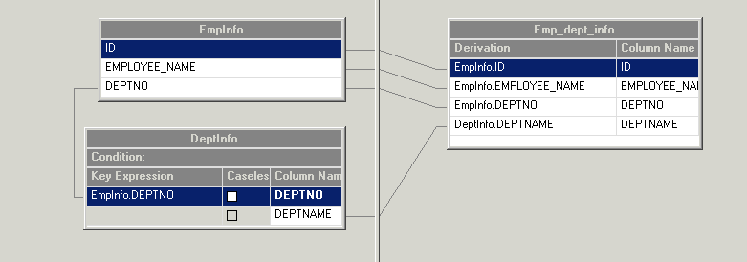
Lookup Stage: Stage Properties
Source link
Reference link
Derivation for lookup key

Slide 101

Lookup stage : Lookup Failure and Conditions
Select action

Slide 102
Lookup stage : Lookup Failure and Actions Properties
When the lookup is not able to find a matching key column , possible actions that can take are :
Continue. The fields from that link are set to NULL if the field is nullable, or to
a default value if not. Continues processing any further lookups before sending
the row to the output link.
Drop Drops the row and continues with the next lookup
Fail. Causes the job to issue a fatal error and stop
Reject. Sends the row to the reject link.
There is no option to capture unused table entries

Slide 103
Lookup Stage : Advanced
Lookup Tables should be small enough to fit into physical memory otherwise, performance hit due to paging
On a MPP you should partition the lookup tables using entire partitioning method or partition them by the same hash key as the source link
  Entire results in multiple copies (one for each partition)
On a SMP, choose entire or accept the default (which is entire)
  Entire does not result in multiple copies because memory is shared

Slide 104


Lookup Stage : Example Job
Output of Lookup with continue option on key DEPTNO
Empty string or NULL
Same output as outer join and merge/keep
Output of Lookup with drop option on key DEPTNO
Records Dropped
Same output as inner join and merge/drop

Slide 105
Module : Merge Stage

Slide 106
Module Objectives
At the end of this module you will be able to:
  Understand the functionality of Merge Stage
  Implement the Merge stage
  Understand the pre-requisites for Merge Stage
  Handle Merge failures and take relevant action

Slide 107

Merge Stage:
Merge Stage
The Merge stage yet another stage to combine data from two dataset or sources
The Merge stage combines a master data set with one or more update data sets. The columns from the records in the master and update data sets are merged so that the output record contains all the columns from the master record plus any additional columns from each update record that are required.
Type of stage (Active/Passive) >> Active stage ; Processing stage
Input/Output Criteria : one sorted, duplicate-free master (primary) link with one or more sorted update (secondary) links and same number of reject links as there are update input links.

Slide 108
Merge Stage :
A master record and an update record are merged only if both of them have the same values for the merge key columns) that you specify.
Merge key columns are one or more columns that exist in both the master and update records
A non-key column name occurs in several inputs?
    The lowest input port number prevails
    E.g., master over update; update values are ignored
The data sets input to the Merge stage must be key partitioned and sorted. This ensures that rows with the same key column values are located in the same partition and will be processed by the same node.
It also minimizes memory requirements because fewer rows need to be in memory at any one time.
Pre-sort makes merge "lightweight“ for memory

Slide 109

Merge Stage: Stage Properties
Master link
Update link
Reject link

Slide 110

Merge stage : Editor and Properties
Merge Key
Unmatched Master rows-2 options:
  Keep [default]
  Drop
  (Masters cannot be capture in reject link)
Unmatched Update rows option:
Capture in reject links)
Implemented by adding outgoing links

Slide 111
Merge stage : Stage Properties
Property | child Property | child Property | Default Value | Available Value
Merge Keys
 | Key
 |  | Sort Order | Ascending | Ascending/ Descending
 |  | Nulls Position | First | First/Last
 |  | Sort as EBCDIC | FALSE | True/False
 |  | Case Sensitive | TRUE | True/False
Options
 |  | Unmatched Master Mode | Keep | Keep/Drop
 |  | Warn on Reject Records | TRUE | True/False
 |  | Warn on Reject Updates | TRUE | True/False

Slide 112

Merge Stage : Example job
Keep Master Records
Drop Master Records
Reject update Records

Slide 113
Module : Join Stage

Slide 114
Module Objectives
At the end of this module you will be able to:
  Understand the functionality of Join Stage
  Implement the Join stage
  Understand the pre-requisites for Join Stage
  Implement various types of join- Inner, Left Outer, Right Outer and Full outer

Slide 115

Join Stage:
Join Stage
It performs join operations on two or more data sets input to the stage and then outputs the resulting data set.
In the Join stage, the input data sets are notionally identified as the “right” set and the “left” set, and “intermediate” sets.
Type of stage (Active/Passive) >> Active stage ; Processing stage
Input/Output Criteria : 2 or more sorted input links, 1 output link
  "left" on primary input, "right" on secondary input
  Pre-sort make joins "lightweight": few rows need to be in RAM
Four types:
  Inner
  Left outer
  Right outer
  Full outer

Slide 116
Join Stage :
The data sets input to the Join stage must be key partitioned and sorted. This ensures that rows with the same key column values are located in the same partition and will be processed by the same node.
Reference Dataset size is of prime concern. Since the ref. data resides in RAM and hence may cause performance issues.
Its advisable to use JOIN when the reference data is large as join does a high-speed sort on the driving and reference datasets. This can involve I/O if the data is big enough, but the I/O is all highly optimized and sequential. Hence it boost the performance
Follow the RDBMS-style relational model
  Cross-products in case of duplicates in primary and secondary links
  Matching entries are reusable for multiple matches
  Non-matching entries can be captured (Left, Right, Full)
No fail/reject option for missed matches

Slide 117

Join Stage: Stage Properties
Join Key
Join type
Four variants:
  Inner
  Left Outer
  Right Outer
  Full Outer
Multiple Key

Slide 118

Join stage : Inner Join
Inner Join transfers records from input data sets whose key columns
contain equal values to the output data set.
Records whose key columns do not contain equal values are dropped
It generates the same output as lookup/reject and merge/drop
Output of inner join on key DEPTNO

Slide 119

Join stage : Left Outer Join
Left outer Join transfers all values from the left data set but transfers
values from the right data set and intermediate data sets only where key
columns match.
The stage drops the key column from the right and intermediate data sets.
It generated the same output as lookup/continue and merge/keep
Check Link Ordering Tab to make sure intended Primary is listed first .
Output of Left Outer Join on Key DEPTNO

Slide 120

Join stage : Right Outer Join
Right outer Join transfers all values from the right data set but transfers
values from the left data set and intermediate data sets only where key
columns match.
The stage drops the key column from the left and intermediate data sets.
Check Link Ordering Tab to make sure intended Primary is listed first .
Output of Right Outer Join on Key DEPTNO
Integer 0 for ID
Blank Name

Slide 121

Join stage : Full Outer Join
Full outer Join transfers records in which the contents of the key columns
are equal from the left and right input data sets to the output data set.
It also transfers records whose key columns contain unequal values from
both input data sets to the output data set.
Full outer joins do not support more than two input links
Output of Full Outer Join on Key DEPTNO

Slide 122
Module : Remove Duplicates Stage

Slide 123
Module Objectives
At the end of this module you will be able to:
  Use the remove duplicate stage to de-dupe input data
  Describe the different operations available

Slide 124

Remove Duplicates Stage :
Active/Processing stage with Single input link and single output link
Takes sorted input data as input and removes duplicate records
Operates both in sequential and parallel modes
Stage :

Slide 125

Remove Duplicates Stage :
Duplicate records are determined and removed based on the key fields mentioned
When running in parallel mode
  Duplicates are removed in partition (and not across partitions)
  Hash partition the input with the same fields mentioned as keys
Dupes can be also be removed using the Unique checkbox

Slide 126

Remove Duplicates Stage : Properties
Key fields based on which duplicates will be removed – Repeatable property
the Only option available
Properties available for key fields

Slide 127

Remove Duplicates Stage : Example
Same partitioning (as sort stage) ensures all records with same key field values be present in the same partition

Slide 128
Module : Funnel Stage

Slide 129
Module Objectives
At the end of this module you will be able to:
  Use the funnel stage to combine input data
  Describe the different operations available

Slide 130

Funnel Stage :
Active/Processing stage with one or many input links and Single output link
Combines input data from multiple links into one output link
Horizontal joining of data
Can be seen as concatenation operator with advanced operations
Modes of operation:
  Continuous Funnel (Default)
  Sort Funnel
  Sequence Funnel
Stage :

Slide 131
Funnel Stage : Properties
All the input links metadata should be the same
Continuous Funnel (Default Funnel Type):
  No defined order in which records are combined
Sequence Funnel :
  Passes all records from first link and then second link and so on for all links.
  Sequence in which records are combined is defined by Link order
Sort Funnel :
  Data is combined in the sorted order of the mentioned key field values
  Requires input data on all links to be sorted on the same keys mentioned
  The output records will be in sorted order (based on the keys)
Notes:
Talk about the impact of partitioning when funnel is set to run in parallel mode
For funnel type : Sequence Funnel
Data is combined and output partition wise i.e, if we are running on a 2 node config data from first partition of two nodes is combined and output as first partition in the output link
For funnel type : Sort Funnel
Data is Sorted, combined and output partition wise i.e, each ouput partition is sorted and not across partitions

Slide 132

Funnel Stage : Properties
Property specific to mode : ‘Sort Funnel’ - Repeatable property
Link Order matters for the Funnel Type : Sequence Funnel
Funnel Type : Other available modes
-> Continuous Funnel
-> Sequence Funnel
Properties available for key fields (available only for funnel type : Sort Funnel)

Slide 133

Funnel Stage : Example

Slide 134
Module : Transformer Stage

Slide 135
Module Objectives
At the end of this module you will be able to:
  Use the Transformer Stage to create derivations
  Use the Transformer Stage to send data to different output links
  Describe the different properties available with Transformer Stage

Slide 136

Transformer Stage :
Transformer Stage allows to create transformations to apply to input data.
    Transformer Stage :
Active/Processing stage with a single input link and any number of output links and, optionally, a single reject link.
Basic operations which can be done using Filter Stage –
    Create transformation logic
    Filter data
    Direct data down different output links Transfer input records which matches the conditions

Slide 137
Transformed data
Derivations may include incoming fields or parts of incoming fields
Derivations may reference system variables and constants
Frequently uses functions performed on incoming values
  Date and time
  Mathematical
  Logical
  Null handling
  More

Slide 138

Transformer Stage : Stage Properties
Stage Variables
Input Columns
Output Columns
Constraints
Mappings

Slide 139
IF THEN ELSE Derivation
Use IF THEN ELSE to conditionally derive a value
Format:
  IF <condition> THEN <expression1> ELSE <expression1>
  If the condition evaluates to true then the result of expression1 will be copied to the target column or stage variable
  If the condition evaluates to false then the result of expression2 will be copied to the target column or stage variable
Example:
  Use State_code to derive state_id
  If state_code is MN then state_id is 1 else it is 0
  IF state_code = ‘MN’ THEN 1 ELSE 0

Slide 140
Transformer Functions
Date & Time
Logical
Mathematical
Null Handling
Number
Raw
String
Type Conversion
Utility
Vector

Slide 141
Stage Variables
Derivations in stage variables are executed from top to bottom order
  Later stage variables can reference earlier stage variables
  Earlier stage variables can reference later stage variables
    However the later stage variables will contain the values which were derived when the previous row was processed.

Slide 142
Order of Execution
Stage variables are evaluated first
Constraints are executed before derivations
Derivations in earlier links are executed before later links
Derivations in higher columns are executed before lower columns

Slide 143
Module : Modify Stage

Slide 144
Module Objectives
At the end of this module you will be able to:
  Use the Modify Stage to alter input schema
  Describe the different properties available with Modify stage

Slide 145

Modify Stage :
Modify Stage alters the record schema of input schema.
    Modify Stage :
Active/Processing stage with a single input link and a single output link.
Basic operations which can be done using Modify Stage –
  Drop or keep columns from input schema
  Change type of column

Slide 146

Modify Stage : Stage Properties
Multiple specifications can be entered. Each will be carried out sequentially
Enter the operation required in ‘Specifications’ field. eg DROP <column name>

Slide 147
Modify Stage : Properties
Usage of Modify Stage
  To Drop or Keep Columns from input schema
    DROP REPID, COMMENTS
    KEEP CUSTID, NAME
  To Change Data Types
    conv_CUSTID:string = string_from_decimal(CUSTID)
  Null Handling – to handle columns that might contain null values
    PHONE:string = NullToValue (PHONE,”NULL”)
Notes:
For clusterKeychange : Atleast one of the sort keys ‘Sort Mode’ should be set as Don’t Sort (Previously Sorted) or Don’t Sort (Previously Grouped), otherwise even if the clusterKeyChange column property is set to true DataStage would ignore it and would not create the clusterKeyChange Column in the ouput.

Slide 148


Modify Stage : Example Job
Example Job to drop the REPID, CREDITLIMIT, and COMMENTS columns from input dataset.
Input Schema for Data_Set_1

Slide 149


Modify Stage : Example Job contd…
Specifications to drop columns
Output Schema for Data_Set_2

Slide 150
Module : Filter Stage

Slide 151
Module Objectives
At the end of this module you will be able to:
  Use the Filter Stage to route rows to different output links
  Describe the different properties available with Filter Stage

Slide 152

Filter Stage :
Filter Stage transfers the input records which satisfy the requirements to output link.
    Filter Stage :
Active/Processing stage with a single input link and any number of output links and, optionally, a single reject link.
Basic operations which can be done using Filter Stage –
  Transfer input records which matches the conditions
  Filter out unmatched record and send to reject link
  Use Different requirements to route records to different output links

Slide 153

Filter Stage : Stage Properties
Specify the expression in “Where Clause” property
Set the Output Link to which the records satisfying the filter criteria should be sent,.

Slide 154

Filter Stage : Link Ordering Tab
This tab allows you to specify the order in which output links are processed. This is important where you have set the Output rows only once property to True.

Slide 155
Filter Stage : Example Job # 1
Comparing Two Fields:
The requirement is – If the salary of an employee is greater than average salary then write to output link ‘above_average’.
Set the following properties in Filter stage –
Where Property = sal > avg_sal
Output Link Property = 2
(In link ordering tab, Set Link Label = 2 for Link Name = ‘above_average’

Slide 156
Filter Stage : Example Job # 2
Testing for nulls:
The requirement is – If the sys_id field in a record is null then write to output link
Set the following properties in Filter stage –
Where Property = sys_id is null
Output Link Property = Stage has only one putput link. So no need to specify this because it will write to output link by default.

Slide 157

Module : Sequence

Slide 158
Module Objectives
Introduction to Sequence
Creating a new sequence
Sequence Job Activities
Sequence properties
Job Flow
Sequencer and parameters
Restartability
Running and Compiling

Slide 159
Introduction to Sequence
A job sequence allows you to specify a sequence of Data Stage actions to take depending on results. It show the flow in graphical way.
It runs special built-in stages which allow you to define sequences of activities to run.
It enables scheduling depending on the business logic
Its design is similar to a job
Once you have defined a job sequence, it can be scheduled and run using the Data Stage Director. It appears in the Data Stage Repository and in the Data Stage Director client as a job

Slide 160

Creating a new sequence
To create a job sequence, choose File ➤ New from the Data Stage Designer menu
Selecting this option will let you create a new Sequence

Slide 161

Creating a new sequence
Once you select New Job sequence Your Designer window will look like picture in slide
Now you can create sequence as follows:
Placing the stages representing the activities in your sequence on the canvas.
Linking the stages together.
Specifying properties details for each activity, defining what it does.
Specifying trigger information for each activity specifying what action is taken on success or failure of the activity.
All these activities are covered in later slides

Slide 162
Naming Job Sequences
The following rules apply to the names that you can give Data Stage
job sequences:
􀂄 Job sequence names can be any length up to 700 characters.
􀂄 They must begin with an alphabetic character.
12344Job100 – wrong Job First – wrong (no space)
Seq100 – Right
&&&133 - wrong
􀂄 They can contain alphanumeric characters and underscores.
Seq1_Read - Right
􀂄 Job sequence names should be meaningful or logical as possible.

Slide 163

Sequencer Job Activities
The job sequence supports the following types of activities:
To add an activity to your job sequence, drag the corresponding icon
from the tool palette and drop it on the Diagram window.

Slide 164
Important Sequence activities - Description
  􀂄 Job activity: Specifies a Data Stage server or parallel job.
  􀂄 Routine: Specifies a routine. This can be any routine in the
  Data Stage Repository (but not transforms).
  􀂄 ExecCommand: Specifies an operating system command to
  execute.
  􀂄 Email Notification: Specifies that an email notification should
  be sent at this point of the sequence.
  􀂄 Wait-for-file: Waits for a specified file to appear or disappear.
  􀂄 Exception Handler: There can only be one of these in a job
  sequence. It is executed if a job in the sequence fails to run (other
  exceptions are handled by triggers) or if the job aborts and the
  automatically handle job runs that fail option is set for that
  job.

Slide 165
Important Sequencer activities - Description
  􀂄 Nested Conditions: Allows you to further branch the execution
  of a sequence depending on a condition.
  􀂄 Sequencer: Allows you to synchronize the control flow of
  multiple activities in a job sequence.
  􀂄 Terminator: Allows you to specify that, if certain situations
  occur, the jobs a sequence is running shut down cleanly.
  􀂄 Start Loop and End Loop: Together these two stages allow you
  to implement a For…Next or For…Each loop within your
  sequence.
  􀂄 User Variable: Allows you to define variables within a
  sequence. These variables can then be used later on in the
  sequence, for example to set job parameters.
  Activities can be named, moved, and deleted in the same way as stages in a job

Slide 166


Sequencer Properties - General
Same sequencer can run with different parameters based on Invocation ID
It enables sequencer to start from last aborted job

Slide 167

Sequencer Properties - Parameters
The Parameters page allows you to specify parameters for the job
sequence. Values for the parameters are collected when the job sequence is run in the Director. The parameters you define here are available to all the activities in the job sequence, so where you are sequencing jobs that have parameters, you need to make these parameters visible here.

Slide 168

Sequencer Properties – Job control
The Job Control page displays the internal code generated when the job
sequence is compiled.

Slide 169


Sequencer Properties – Dependencies
The Dependencies page of the Properties dialog box shows you
the dependencies the job sequence has. These may be functions, routines, or jobs that the job sequence runs

Slide 170


Different Job Activity flows in a Sequence
Sequence Job Activity flow specifies some complex flow of control as follows:
  Find parameter values
  Run jobs in Loops
  Wait for file before run
  Run a Unix command/routine before/after a job
  Email notify after run

Slide 171


Job Activity Properties
The Job page contains:
􀂄 Job name: Allows you to specify the name of the job the activity
is to run. You can select a job by browsing the Repository.
􀂄 Invocation ID Expression: This only appears if the job identified
by Job Name has Allow Multiple Instance enabled. You cannot leave this field blank.
􀂄 Execution Action: Allows you to specify what the activity will do
with the job. Choose one of the following from the drop-down list:
  Run (the default)
  Reset if required then run
  Validate only
  Reset only
Other Properties ( parameters and triggers) are covered in next slides

Slide 172


Job Activity Properties -Triggers in Sequence
The control flow in the sequence is dictated by how you interconnect
activity icons with triggers.

Slide 173
Triggers in Sequence
Three types of dependency between activities in a sequencer defined in Triggers:
􀂄 Conditional: A conditional trigger fires the target activity if the
source activity fulfills the specified condition. The condition is
defined by an expression, and can be one of the following types:
  OK. Activity succeeds.
  Failed. Activity fails.
  Warnings. Activity produced warnings.
  Return Value. A routine or command has returned a value.
  Custom. Allows you to define a custom expression.
  User status. Allows you to define a custom status message to
  write to the log.
􀂄 Unconditional: An unconditional trigger fires the target activity
once the source activity completes, regardless of its status after run.
􀂄 Otherwise: An otherwise trigger is used as a default when none of the
conditional ones have fired.

Slide 174

Sequencer and Parameters
In the Job activity properties we can relate the sequencer level parameters with job parameters. Here the grid displays all the parameters expected by the job.
By Typing in an expression giving a value for the parameter in the
value Expression column.
Select a parameter and click Insert Parameter Value to use
another parameter or argument in the sequence to provide the
value.
You can select a parameter and click Set to Default to enter the
default for that parameter as defined in the job itself.
You can calculate a parameter value by the help of a user variable activity
All these are explained in next slides

Slide 175

Passing Parameters to Jobs
Passing Sequencer level parameter value to Job
Getting parameter from user variable activities

Slide 176

Passing Parameters to Jobs
Job Name as parameter
Passing combination of Sequencer parameters
Hard coding parameter values

Slide 177


Sequencer’s Restartability
Job sequences are optionally
re-start able. If you run a restart able
sequence and one of the jobs fails to finish correctly, you can fix the
problem, then re-run the sequence from the point at which it left off.

Slide 178
Sequencer’s Restartability
If a sequence is restart able (i.e., is recording checkpoint information)
and has one of its jobs fail during a run, then the following status
appears in the Data Stage Director: Aborted/restartable.
In this case you can take one of the following actions:
􀂄 Run Job. The sequence is re-executed, using the checkpoint
information to ensure that only the required components are re-executed
􀂄 Reset Job. All the checkpoint information is cleared, ensuring
that the whole job sequence will be run when you next specify run
job.

Slide 179

Job Activity Restartability
In the job activity properties you will see
Do not checkpoint job run. Set this to specify that Data Stage does not record checkpoint information for this particular job. This means that, if another job later in the sequence fails, and the sequence is restarted, this job will be rerun regardless of the fact that it finished successfully before. This option is only visible if the sequence as a whole is check pointed.

Slide 180
Running and Compiling
Double click this button to compile
Double click this button to run the sequence with parameters hardcoded or providing at run time
Job sequences can be compiled by:
Designer
Manager
Command prompt
Job sequences can be run by:
Designer
Director
Administrator
Command prompt

Slide 181
Running and Compiling
Compiling from command prompt
dscc /h etlp801 /u amar1 /p pword dstageprj /J jobxxx
Will connect to the machine etlp801, with a username/password as
amar1/pword , attach to the project dstageprj and compile the job with name jobxxx
Running from command prompt
dsjob –run dstageprj jobxxx
Will attach to the project dstageprj and run the job with name jobxxx

